Slide 1
Donation Analytics for June 2025
View in Power BI
Presented by Jamie Tian

Slide 2
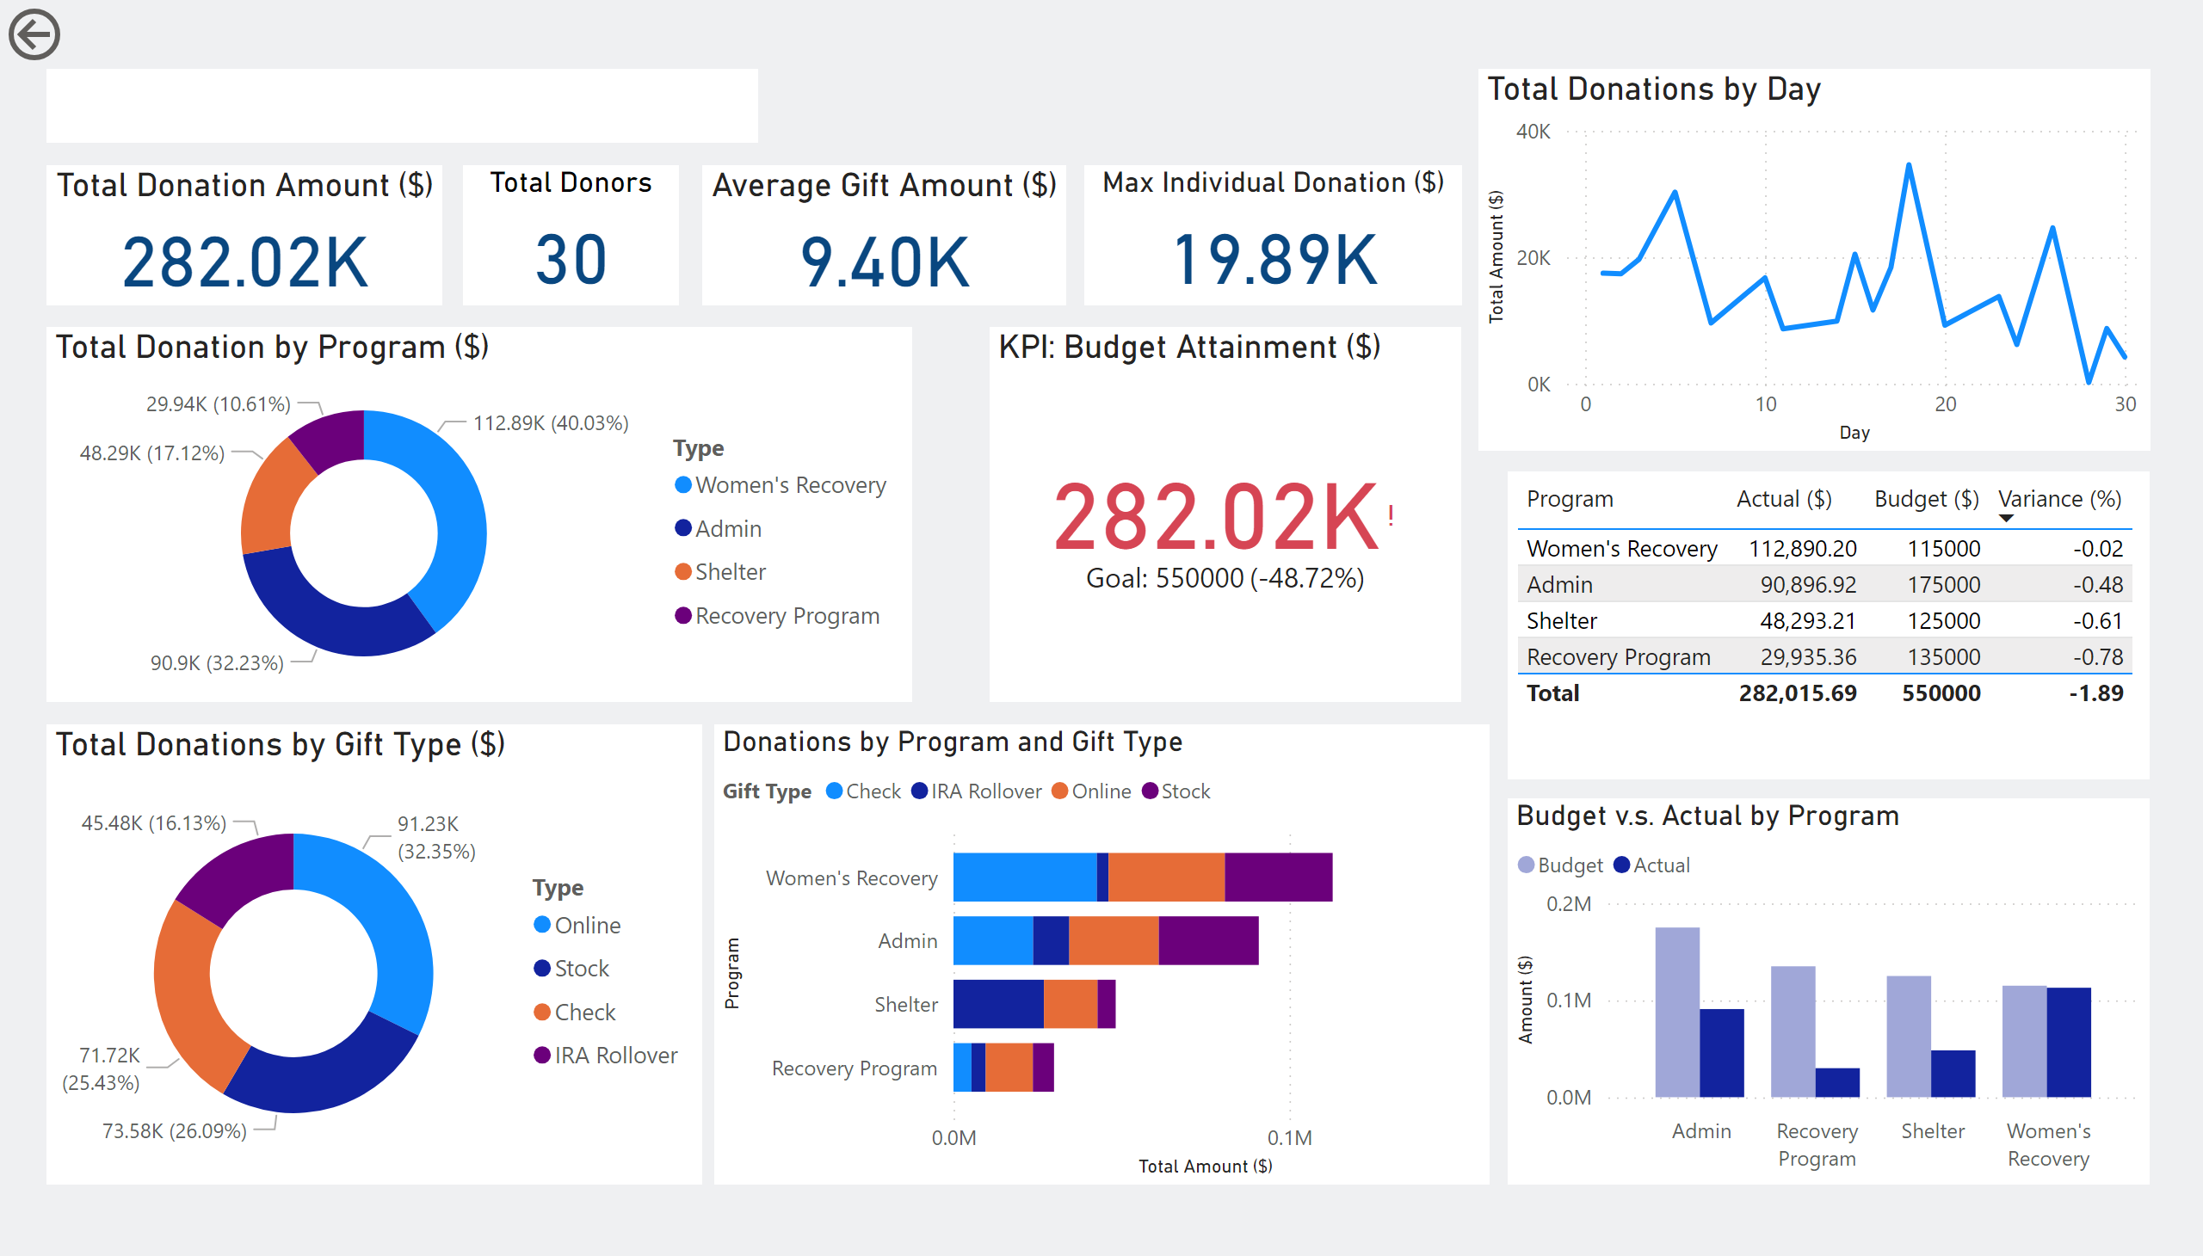
Page 1
Preview
Donation Analytics for June 2025
This project summarizes June 2025 donations from individual gifts to planned commitments. It helps us track giving, compare results to goals, and use data to strengthen our fundraising and impact.
Notes:
textbox
No alt text provided
Total Donations by Gift Type ($)
No alt text provided
Donations by Program and Gift Type
No alt text provided
Max Individual Donation ($)
No alt text provided
Total Donations by Day
No alt text provided
Total Donation by Program ($)
No alt text provided
Average Gift Amount ($)
No alt text provided
Total Donors
No alt text provided
Total Donation Amount ($)
No alt text provided
Budget v.s. Actual by Program
No alt text provided
KPI: Budget Attainment ($)
No alt text provided
tableEx
No alt text provided
actionButton
No alt text provided

Slide 3
Data creation
Method: Manual Entry
Raw donation log capturing each gift individually
Fields: donor, amount, gift type, program, date
Includes reconciliation status (Yes/No)

Slide 4

Data cleaning
- Standardized version of the Manual Entry sheet
- Adds “Reconciled Label” for easier filtering
- Ready for analysis, dashboards, and reporting
- Used as the core data source in Power BI

Slide 5
Budget vs Actual
Program | June Budget ($) | June Actual ($) | Variance ($) | Variance (%)
Recovery Program | 135000 | 29935.36 | -105064.64 | -0.78
Shelter | 125000 | 48293.21 | -76706.79 | -0.61
Women's Recovery | 115000 | 112890.2 | -2109.80 | -0.02
Admin | 175000 | 90896.92 | -84103.08 | -0.48
Shows program-level budgets vs actual donations
Includes dollar and percentage variances
Highlights over- and under-performing areas
Ideal for KPI tracking and performance reviews

Slide 6
Planned Giving
Donor | Gift Type | Commitment Date | Estimated Value | Expected Receipt | Program | Status
Evelyn Parker | Bequest | 02/20/2025 | 45000 | 02/20/2026 | Recovery Program | Pending
Michael Chen | IRA Rollover | 04/15/2025 | 82000 | 04/15/2025 | Shelter | Received
Sophia Sanchez | Charitable Remainder Unitrust | 06/05/2025 | 58000 | 06/05/2025 | Women's Recovery | Pending
William Turner | Stock | 06/18/2025 | 30000 | 06/18/2025 | Admin | Received
Tracks future donation commitments (e.g., bequests, IRAs)
Includes donor, value, dates, and program designation
Helps with long-term financial forecasting

Slide 7
Pivot Tables (Programs & Gift Types)
Program Type | Sum of Amount
Admin | 90896.92
Recovery Program | 29935.36
Shelter | 48293.21
Women's Recovery | 112890.20
Grand Total | 282015.69
Donation totals grouped by program and gift type
Quick insights into where funding is coming from
Useful for trend spotting and donor behavior analysis
Supports visual slices and filters in dashboards
Gift Type | Sum of Amount
Check | 71724.13
IRA Rollover | 45478.15
Online | 91234.93
Stock | 73578.48
Grand Total | 282015.69

Slide 8
Power bi Visualization

Slide 9
Page 1
Donation Analytics for June 2025
Notes:
textbox
No alt text provided
Total Donations by Gift Type ($)
No alt text provided
Donations by Program and Gift Type
No alt text provided
Max Individual Donation ($)
No alt text provided
Total Donations by Day
No alt text provided
Total Donation by Program ($)
No alt text provided
Average Gift Amount ($)
No alt text provided
Total Donors
No alt text provided
Total Donation Amount ($)
No alt text provided
Budget v.s. Actual by Program
No alt text provided
KPI: Budget Attainment ($)
No alt text provided
tableEx
No alt text provided
actionButton
No alt text provided

Slide 10
Dashboard Summary for June 2025
Total donations, donor count, and average gift tracked clearly
Budget vs. Actual visual shows program large performance gaps
Online and stock gifts led in total contribution by type
Most donations concentrated around key giving days
Women's Recovery performed closest to budget target
Future Action: focus on high-performing channels and address underfunded programs

Slide 11
Embrace change. Lead the future.

